Slide 1
OGC-Khronos ISG Sprint Demo Event: Cesium | Bao Tran, 3D Developer
September 25, 2020

Slide 2
CDB to 3D Tiles Overview
Create CDB to 3D Tiles Converter
Support Terrain, Imagery, and GSModels conversions
Support material batching to reduce draw calls to maintain solid runtime rendering performance
The tiling schemes and levels of detail in the converted 3D Tiles complies with the CDB specification
Future plan is to experiment with CDB partial updates and on the fly conversion with implicit tiling schemes in 3D Tiles Next
<number>

Slide 3
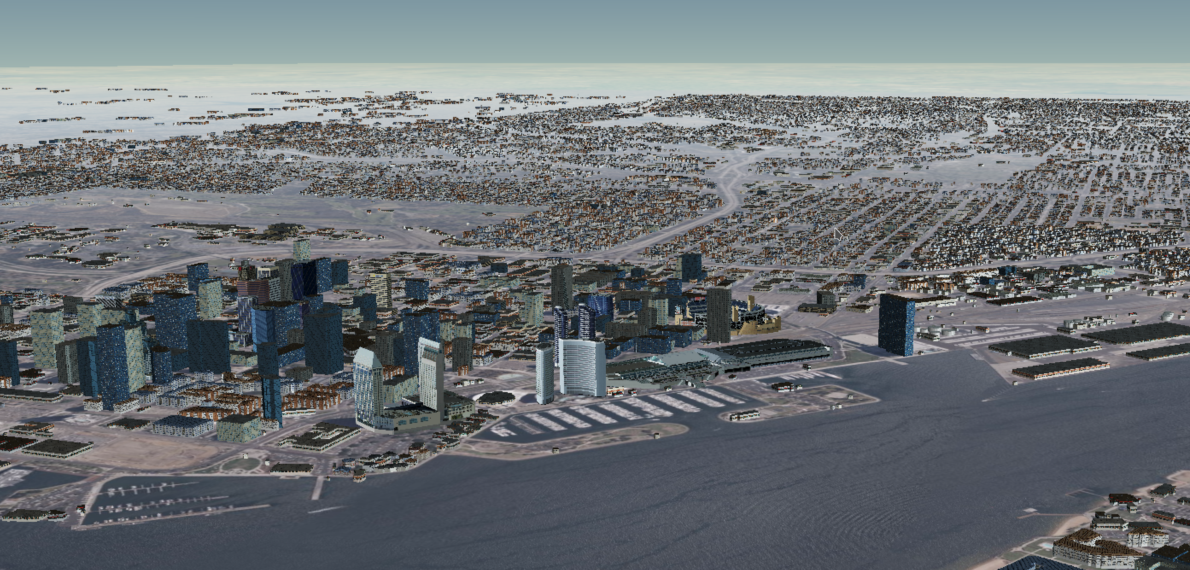
Demo Video

Slide 4
Thank you.
<number>

